Slide 1
Hands On Lab Instructor Notes
Estimated duration: 3-4 Hours
Student computer requirements - see next slide
Students should have basic experience with deploying Azure resources via the Portal and an understanding of Resource Groups.

Slide 2
Student PC Requirements
Visual Studio Code https://code.visualstudio.com/
Visual Studio Code Extensions:
Azure Resource Manager Tools
Owner or Contributor access to an Azure subscription
Azure SDK 2.9.+
Latest Azure PowerShell Cmdlets
https://azure.microsoft.com/en-us/downloads/
Ensure you reboot after installing the SDK or Azure PowerShell will not work correctly
Git client https://git-scm.com/download/
Internet access

Slide 3
Introduction to Azure Resource Manager (ARM) Templates
Kevin Hilscher, Cloud Solution Architect

Slide 4
Goals
Quick intro to the Azure Resource Manager (ARM)
Understand the anatomy of an ARM template
Create, debug and deploy an ARM template
Check an ARM template into a source code repository
Deploy an ARM template using a VSTS release pipeline

Slide 5
Quick Intro to ARM
It’s a REST API!
Supports HTTP GET, PATCH, PUT, POST, DELETE.
You send JSON as the HTTP payload.
These are effectively ARM templates formatted in JSON.
Explore it at https://resources.azure.com/
ARM allows you to take resources (Azure services) and put them together into a solution, and deploy, manage them as a group (Resource Group).
Notes:
Declarative templates vs scripts
Repeatable deployments
RBAC
Tagging
Billing

Slide 6
Example
"resources": [
{
"apiVersion": "2016-01-01",
"type": "Microsoft.Storage/storageAccounts",
"name": "mystorageaccount",
"location": "westus",
"sku": {
"name": "Standard_LRS"
},
"kind": "Storage",
"properties": {
}
}
]
PUT
https://management.azure.com/subscriptions/{subscriptionId}/resourceGroups/{resourceGroupName}/providers/Microsoft.Storage/storageAccounts/mystorageaccount?api-version=2016-01-01
BODY
{
"location": "westus",
"properties": {
}
"sku": {
"name": "Standard_LRS"
},
"kind": "Storage"
}

Slide 7
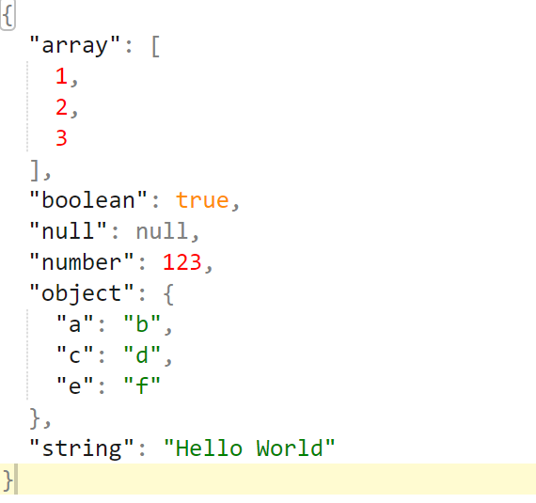
Quick JSON Review
Notes:
http://jsoneditoronline.org/
Leaner and less verbose than XML.
Nested arrays are supported.
Braces
Null must be stated; no blank.
Ambiguous: “somevalue”: 1
No comments allowed
Commas

Slide 8
Anatomy of an ARM Template

Slide 9
Deploying with Azure Resource Manager
template-driven
declarative
idempotent
multi-service
multi-region
extensible

Slide 10
Resource Group
container for multiple resources
RESOU
R
CE G
R
OUP

Slide 11
Resource group
Resources in your group should share the same lifecycle
Each resource can only exist in one resource group
You can add or remove a resource to a resource group at any time
You can move a resource from one resource group to another group
A resource group can contain resources that reside in different regions
A resource group can be used to scope access control for administrative actions
A resource can be linked to a resource in another resource group when the two resources must interact with each other but they do not share the same lifecycle
Notes:
https://azure.microsoft.com/en-us/documentation/articles/resource-group-move-resources/
The scope for a resource link can be a subscription, resource group or a specific resource.

Slide 12
imperative vs. declarative
New-AzureRmVM –VM $myVM
New-AzureRmStorageAccount –StorageAccountName $acct
Set-AzureRmVNetConfig –ConfigurationPath -Path
{
"$schema": "https://../deploymentTemplate.json#",
"contentVersion": "1.0.0.0",
"parameters": {},
"variables": {},
"resources": [],
"outputs": {}
}
Notes:
With imperative programming, you tell the compiler what you want to happen, step by step.
Example: PS
With declarative programming, you write code that describes what you want, but not necessarily how to get it

Slide 13
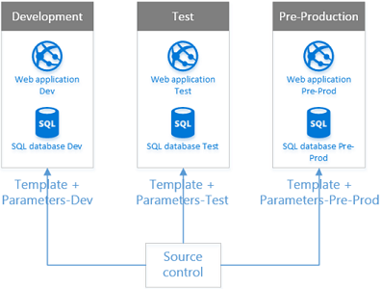
Typical process
Plan Azure resource
Download and customize existing template and parameter file
Create resource group
Deploy resources
Maintain / redeploy
Delete resource group

Slide 14
What you need to start
Visual Studio Code https://code.visualstudio.com/
Visual Studio Code Extensions:
Azure Resource Manager Tools
Owner or Contributor access to an Azure subscription
Azure SDK 2.9.+
Latest Azure PowerShell Cmdlets
https://azure.microsoft.com/en-us/downloads/
Ensure you reboot after installing the SDK or Azure PowerShell will not work correctly
Git client https://git-scm.com/download/
Internet access
Notes:
https://azure.microsoft.com/en-us/documentation/articles/powershell-install-configure/
https://www.visualstudio.com/en-us/features/azure-tools-vs.aspx

Slide 15
Deploy a Linux VM using PowerShell
Notes:
You will deploy a Linux VM from an ARM Template. After you deploy it we will discuss the ARM template itself and the commands used.

Slide 16
Steps
cmd
mkdir ARM
cd ARM
git clone https://github.com/khilscher/ARM_HoL.git
Login-AzureRmAccount
(Watch for authentication pop-up)
Select-AzureRmSubscription -SubscriptionName "Microsoft Azure Internal Consumption"
New-AzureRmResourceGroup -Name TestRG1 -Location “West US"
New-AzureRmResourceGroupDeployment -ResourceGroupName TestRG1 -TemplateFile .\azuredeploy.json -TemplateParameterFile .\azuredeploy.parameters.json
Notes:
While students are waiting for VM to build, go on to next Demo (QuickStart Template)

Slide 17
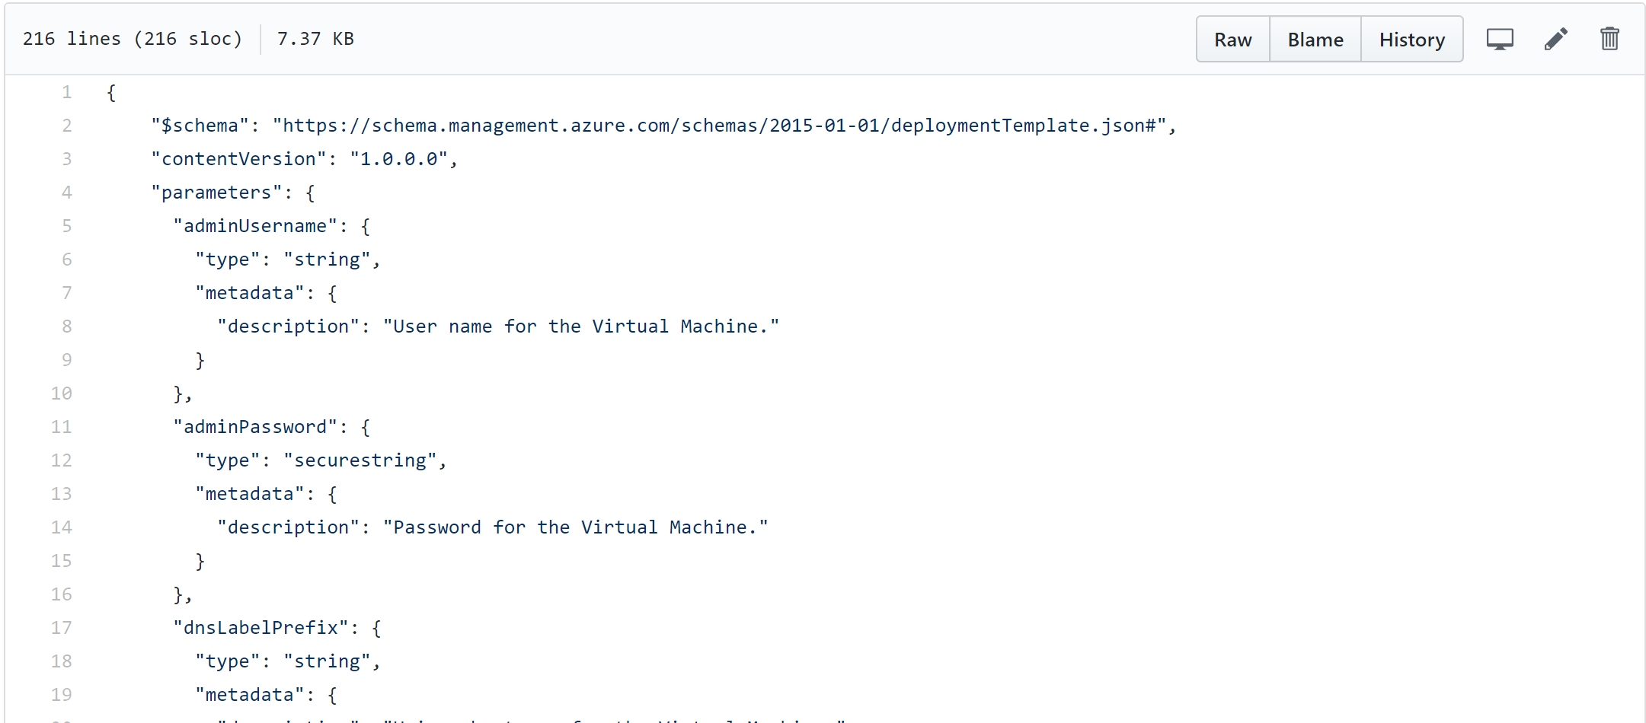
Linux VM ARM Template Walkthrough
https://github.com/khilscher/ARM_HoL/tree/master/LinuxVM

Slide 18
Cmdlets used
Login-AzureRmAccount
Select-AzureRmSubscription -SubscriptionID
New-AzureRmResourceGroup -Name -Location
Test-AzureRmResourceGroupDeployment -ResourceGroupName -Mode -TemplateFile -myParameterName
New-AzureRmResourceGroupDeployment -Name -ResourceGroupName -TemplateFile –myParameterName
Get-AzureRmResourceGroupDeployment -ResourceGroupName -Name
Notes:
-Tag @{Name = "costcenter"; Value="1023"}

Slide 19
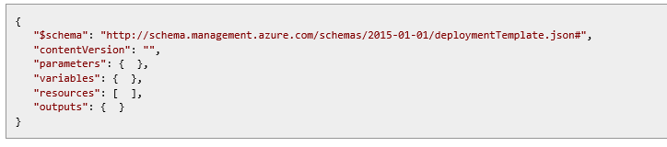
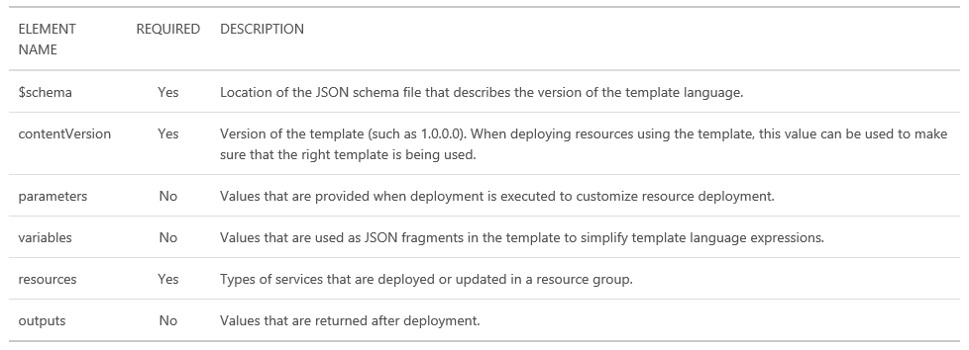
Template composition

Slide 20
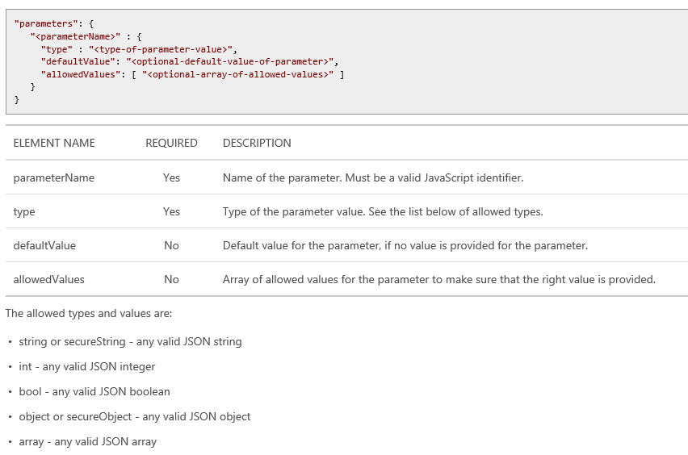
Parameters

Slide 21
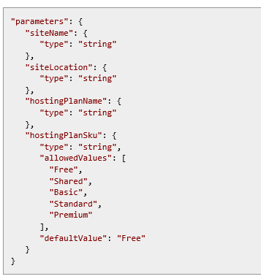
Parameter example

Slide 22
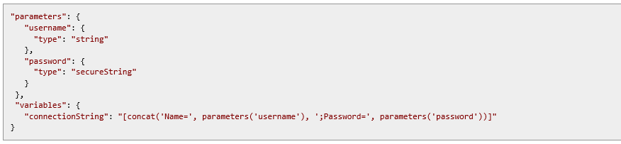
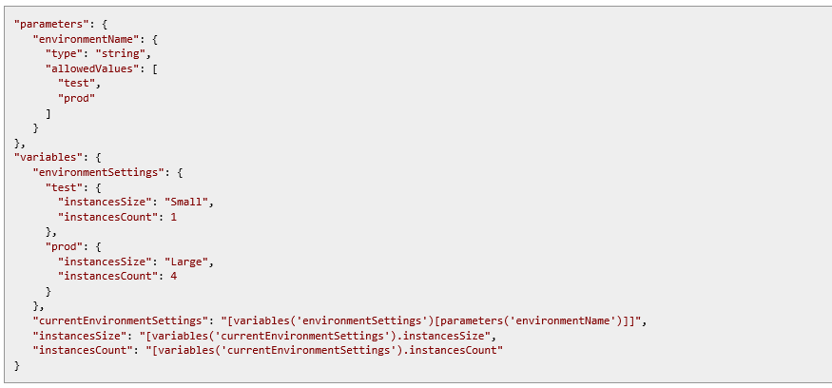
Variables

Slide 23
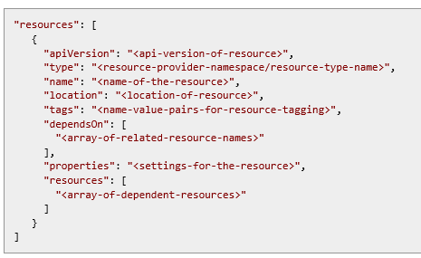
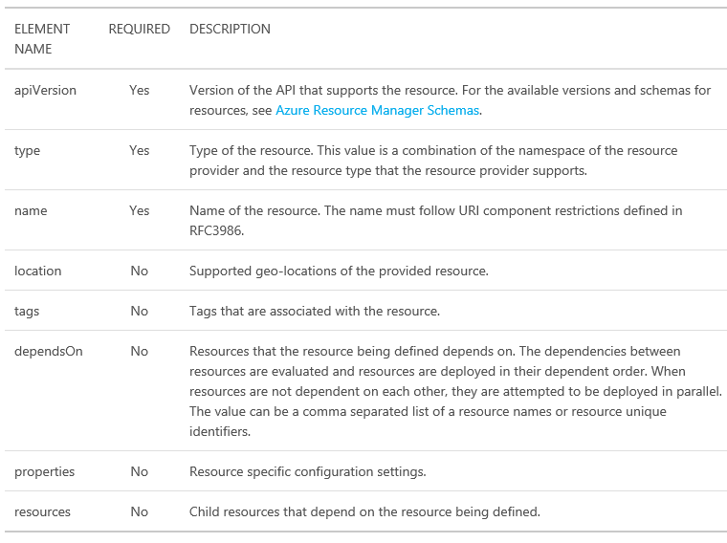
Resources

Slide 24
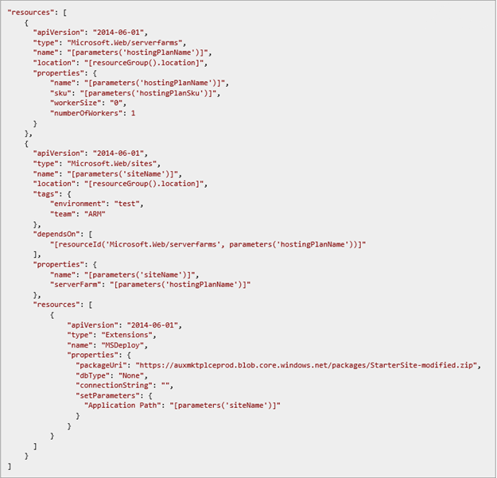
Resource example

Slide 25
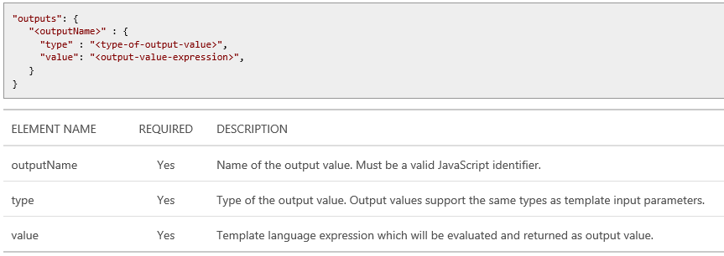
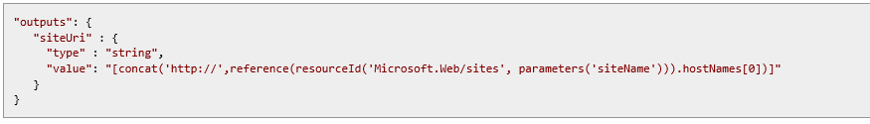
Outputs – passing state

Slide 26
Passing State – Output variables
A template can return values to its caller via the outputs section
These values can then be used by the caller
"outputs": {
"masterip": {
"value":
"[reference(concat(variables('nicName'),0)).ipConfigurations[0].properties.privateIPAddress]",
"type":"string"
}}
"masterIpAddress": {
"value":
"[reference('master-node').outputs.masterip.value]"
} }

Slide 27
Template language functions and expressions
copyIndex(offset) – returns the current index of an iteration loop
length(array) – returns the number of elements in an array
listKeys(storageAccountResourceId, apiVersion) – returns the keys of a storage account
parameters(‘parameterName’) – returns a parameter value
providers(namespace, resourceType) – returns information about a resource provider
reference(resourceId,apiVersion) – enables an expression to derive its value another resource’s runtime state
resourceGroup() – returns a structured object that represents the current resource group
resourceId(‘namespace/resourceType', ‘resourceName’) – used to return a unique resource identifier when referring to an object outside of the current resource group
subscription() – returns details about the subscription
variables(‘variables’) – returns the value of a variable

Slide 28
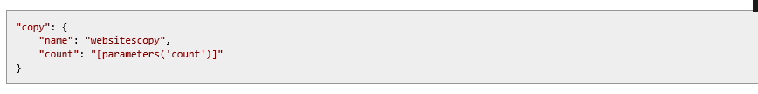

Creating multiple instances of a resource type
copy, copyIndex, and length
Define a copy object that specifies the number of times to iterate
Use copyIndex to access the current iteration value
Use length function to determine the number of iterations based on an array of values

Slide 29
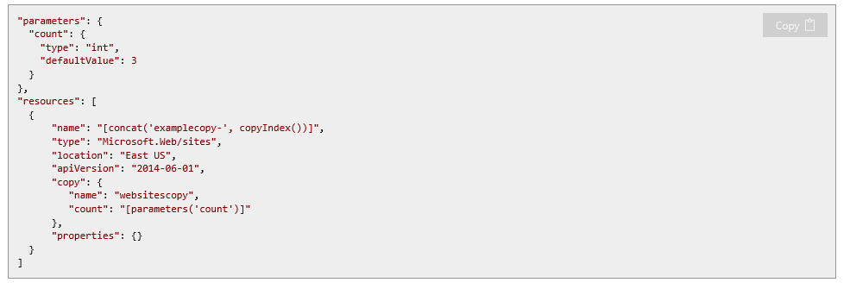

Multiple resource instances – looping on an index value

Slide 30
Schema and apiVersion
Schema
Always use the top level schema https://schema.management.azure.com/schemas/2015-01-01/deploymentTemplate.json# which points https://github.com/Azure/azure-resource-manager-schemas
That will pull in the proper version of all the child schemas. We update the child schemas so all your existing templates don't have to be updated. Multiple API versions are supported in the child schemas to support "backward compat".
apiVersion
(Get-AzureRmResourceProvider -ProviderNamespace Microsoft.Insights).ResourceTypes | Where {$_.ResourceTypeName -eq 'components'} | Select -ExpandProperty ApiVersions
2015-05-01
2014-12-01-preview
2014-08-01
2014-04-01
Notes:
Best Practice: always run the PowerShell command mentioned above to retrieve the API versions information and use the latest one.

Slide 31

Inside the Box vs. Outside the Box
Template describes the topology (outside the box)
Template extensions can initiate state configuration (inside the box)
Multiple extensions available
DSC
Chef
Puppet
Custom Scripts
AppService + WebDeploy
SQLDB + BACPAC

Slide 32
Leveraging Quickstart templates
Notes:
https://github.com/Azure/azure-quickstart-templates/tree/master/101-vm-simple-windows

Slide 33
Deploy using the Azure Portal

Slide 34
Create, debug, deploy an ARM Template
Notes:
Debug - https://docs.microsoft.com/en-us/azure/azure-resource-manager/resource-manager-common-deployment-errors

Slide 35
Lab – Customizing an ARM Template
Customize the Linux ARM template at https://github.com/khilscher/ARM_HoL/tree/master/LinuxVM to:
Deploy a different VM size
Hint: Get-AzureRmVMSize -Location 'West US’
Deploy a different OS image
Hint: Get-AzureRMVMImagePublisher, Get-AzureRMVMImageOffer, Get-AzureRMVMImageSku
Create a VNet name based on an input parameter
Create a NSG name based on the VNET name with “-nsg” appended
Notes:
https://docs.microsoft.com/en-us/azure/virtual-machines/windows/cli-ps-findimage

Slide 36
Check an ARM template into a source code repository
Notes:
https://kevinhilscher.visualstudio.com/CI-CD%20Demos

Slide 37
Key Git Commands
git clone
git status
git add .
git commit –m “some comment”
git push

Slide 38
Deploy an ARM template using a VSTS release pipeline

Slide 40
Appendix

Slide 41
Tools
Visual Studio 2015 or Visual Studio Code
Resource Explorer https://resources.azure.com
Export template from Azure Portal
Schemas
https://github.com/Azure/azure-resource-manager-schemas
https://azure.microsoft.com/en-us/documentation/articles/resource-manager-supported-services/
Audit logs
Quickstart templates
https://github.com/Azure/azure-quickstart-templates
https://azure.microsoft.com/en-us/documentation/templates/
Visualisation http://armviz.io

Slide 42
Custom Script Extension
The script needs to be stored in Azure Blob storage, or any other location accessible through a valid URL.
https://docs.microsoft.com/en-us/azure/virtual-machines/windows/extensions-customscript
{
"apiVersion": "2015-06-15",
"type": "Microsoft.Compute/virtualMachines/extensions",
"name": "config-app",
"location": "[resourceGroup().location]",
"dependsOn": [
"[concat('Microsoft.Compute/virtualMachines/', variables('vmName'),copyindex())]",
"[variables('musicstoresqlName')]"
],
"tags": {
"displayName": "config-app"
},
"properties": {
"publisher": "Microsoft.Compute",
"type": "CustomScriptExtension",
"typeHandlerVersion": "1.9",
"autoUpgradeMinorVersion": true,
"settings": {
"fileUris": [
"script location"
]
},
"protectedSettings": {
"commandToExecute": "myExecutionCommand",
"storageAccountName": "myStorageAccountName",
"storageAccountKey": "myStorageAccountKey"
}
}
}
Notes:
https://docs.microsoft.com/en-us/azure/virtual-machines/windows/extensions-customscript

Slide 43
Desired State Configuration (DSC)
Used for CM e.g. Install IIS
Requires Windows VM + DSC Extension
Alternatively use Chef, Puppet or other CM tool.
configuration IISInstall
{
node "localhost"
{
WindowsFeature IIS
{
Ensure = "Present"
Name = "Web-Server"
}
}
}

Slide 44
Cmdlets reference
Executing with PowerShell
First you need to install Azure PowerShell - Read this article to install Azure PowerShell. Once installed, launch Azure PowerShell and execute
Login-AzureRMAccount - to login into your Azure Subscription and access Azure RM resource commands.
List available Resource Providers
Get-AzureRmResourceProvider -ListAvailable
Get supported locations for a SQL Resource Provider Visit http:///www.sarveshgoel.com for updated version of this article and latest articles
((Get-AzureRmResourceProvider -ProviderNameSpace Microsoft.Sql).ResourceTypes | whereobject ResourceTypeName -eq servers).Locations
Get API Versions of a Resource Provider
((Get-AzureRmResourceProvider -ProviderNamespace Microsoft.Web).ResourceTypes | WhereObject ResourceTypeName -eq sites).ApiVersions
Create a New Resource Group
New-AzureRmResourceGroup -Name MyNewResourceGroup -Location "East Asia"
Deploy ARM Template
New-AzureRmResourceGroupDeployment -ResourceGroupName MyNewResourceGroup -TemplateFile C:\SarveshARM\Templates\NewSampleVM.json
Deploy ARM Template with dynamic Parameters
PS C:\> New-AzureRmResourceGroupDeployment -ResourceGroupName MyNewResourceGroup -TemplateFile C:\SarveshARM\Templates\NewSampleVM.json -hostingPlanName freeplaneast -serverName testserver -administratorLogin testadmin
You will be prompted for password (as Secure String) depending on ARM template.

Slide 45
Cmdlets reference
Move a Resource to another Resource Group
$resource = Get-AzureRmResource -ResourceName ExampleApp -ResourceGroupName OldRG Move-AzureRmResource -DestinationResourceGroupName NewRG -ResourceId $resource.ResourceId
Remove a Resource from Resource Group
Remove-AzureRmResource -Name NewSampleVM -ResourceGroupName MyNewResourceGroup -ApiVersion 2015-08-01
Delete a Resource Group
Remove-AzureRmResourceGroup -Name MyNewResourceGroup
Troubleshoot Deployment
(Get-AzureRmResourceGroupDeploymentOperation -DeploymentName TestDeployment -ResourceGroupName TestGroup).Properties.StatusMessage Visit http:///www.sarveshgoel.com for updated version of this article and latest articles

Slide 46
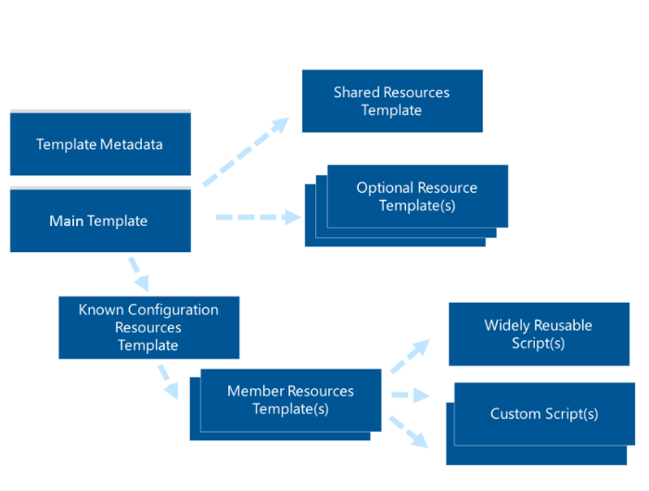
Template composition

Slide 47
Deploying Multiple Instances
{ "apiVersion": "2015-05-01-preview",
"type": "Microsoft.Compute/virtualMachines",
"name": "[concat(parameters('vmNamePrefix'), copyindex())]",
"location": "[parameters('location')]",
"copy": {
"name": "virtualMachineLoop",
"count": "[parameters('numberOfInstances')]"
},
"dependsOn": [
"[concat('Microsoft.Network/networkInterfaces/', 'nic', copyindex())]"
],
"properties": {
"hardwareProfile": {
"vmSize": "[parameters('vmSize')]"
},
"osProfile": {
"computername": "[concat('vm', copyIndex())]",
"adminUsername": "[parameters('adminUsername')]",
"adminPassword": "[parameters('adminPassword')]"
},
"storageProfile": {
"osDisk": {
"name": "[concat(parameters('vmNamePrefix'),'-osDisk',copyindex())]",
"osType": "[parameters('osType')]",
"caching": "ReadWrite",
"image": {
"uri": "[variables('userImageName')]"
},
"vhd": {
"uri": "[concat(variables('osDiskVhdContainer'),parameters('vmNamePrefix'),copyindex(),'osDisk.vhd')]"
}
}
},
Resource loops deploy n instances
Fixed or parameter driving instance count
Concat + Parameter Prefix + CopyIndex() for dynamic naming

Slide 48
Multiple VMs

Slide 49
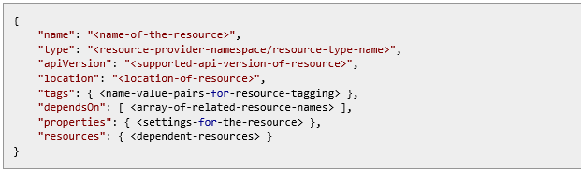
Defining dependencies
dependsOn: defines dependencies on other resources that must be available before creating this resource. Note: there is a performance cost.
resources: allows you to specify child resources that are related but are not relevant to deployment optimization. Note: Child resources can only be defined 5 levels deep and this does not provide dependsOn functionality

Slide 50
ARM generic cmdlets use cases
Execute and manage deployments
New-AzureResourceGroupDeployment
Create individual resources
New-AzureResource
Invoke specific actions on existing resources
Invoke-AzureResourceAction

Slide 51
ARM Resource Providers specialized cmdlets
Interact with underlying Azure Resource Providers
Compute
Storage
Networking
Other services (e.g. Azure SQL DB)
Typed parameters and specialized tasks
E.g. reboot a VM, change a configuration, etc.

Slide 52
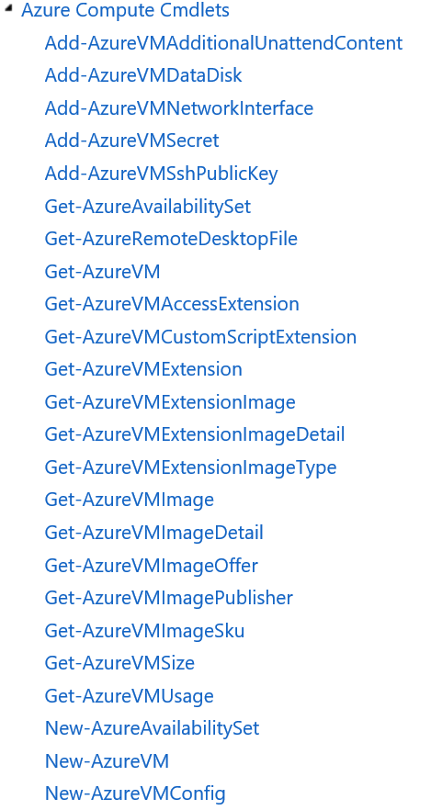
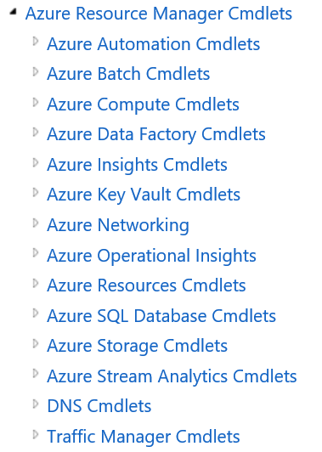
Example of Resource Provider specific cmdlets

Slide 53



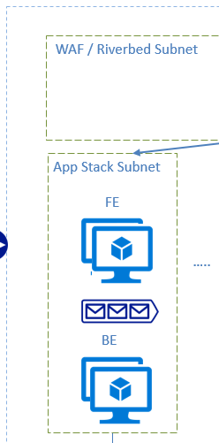








Example of a large solution deployment
Deployment Pods
Roles
Shared Resources
Deployment engine Subnet
WAF / Riverbed Subnet
App Stack Subnet
App Stack Subnet
Common components Subnet
Zabbix/Nagios Subnet
FE
FE
…..
ELK Subnet
BE
BE
Management VNET
Prod VNET 1

Slide 54
Known Configurations/SKUs vs. Free Form
Lots of variables makes free form less desirable
Potentially different VM types, different number of disks, and instances
Hadoop with 8 master nodes w/ 4 attached disks and 16 disks pooled on each data node would have 208 VMs and 3232 disks.
Resource constraints need to be factored on the fly
No math capabilities in ARM language
Harder to price, manage, support for the Enterprise, SI, or CSV
T-shirt Sizes / SKUs are the common approach
Known configuration makes testing easier
Easier to model cost/price
Easier to support
Easier to manage
Allows for better density within a subscription

Slide 55
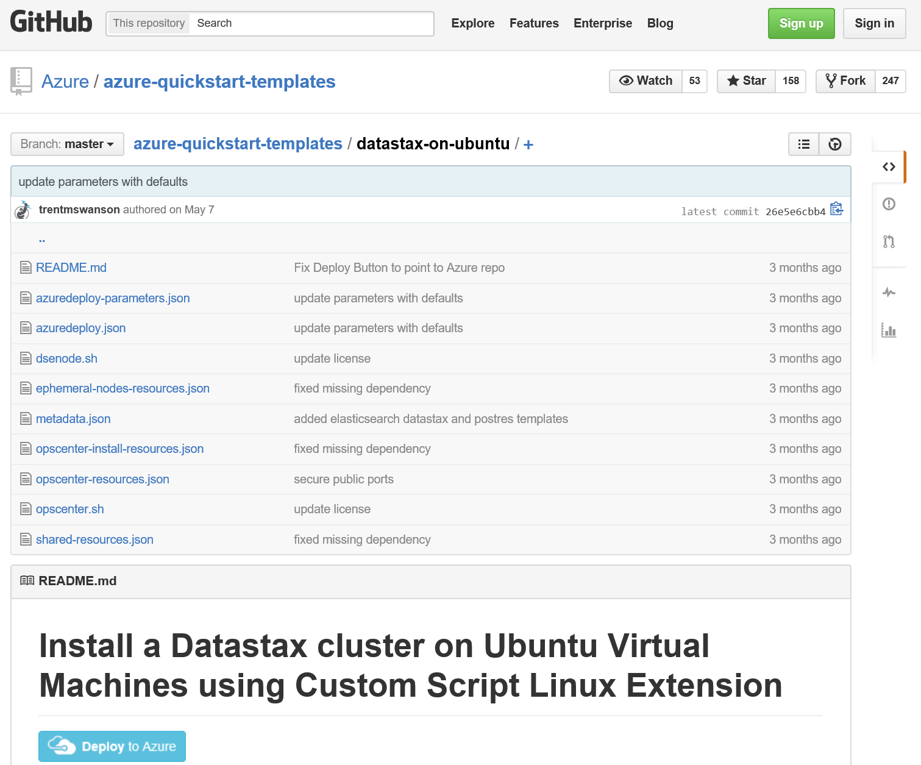
Example of a complex ARM template

Slide 56
Deploy a complex solution using ARM templates

Slide 57
Common Template Scopes
Capacity
May be one or more linked templates with a scoped purpose
Delivers an environment, with appropriate security and auditing for compliance
Capability
May be one or more linked templates with a scoped purpose
Delivers a technology or a capability that can be utilized post-deployment
Examples include delivering capabilities such as SQL Server, Cassandra, Elasticsearch, Hadoop, a Web Server, etc.
End to End Solution
Compositions of one or more capability scoped templates
Examples include end to end data pipeline

Slide 58


Creating “roles” or “tiers”
Specialize VMs based on their role or desired configuration
VM Scale Set can now be used (GA)
Heavily based on VM Extensions
Windows and Linux platform and custom images
Ideal for clusters
VM Code
VM Code
Backup
Extension
Monitoring
Extension
VM Code
…
VM Code
…
Backup
Extension
Monitoring
Extension
VM Code
Backup
Extension
Monitoring
Extension
…
Runtime and Extension API
…
Backup
Extension
Monitoring
Extension
…
Runtime and Extension API
Backup
Extension
Monitoring
Extension
VM Agent
Runtime and Extension API
VM Agent
Runtime and Extension API
VM Agent
Runtime and Extension API
VM Agent
VM Agent

Slide 59
Template Linking
Provides the ability to link multiple templates
Can be used to facilitate decomposition
Template URIs can be dynamic
Allows for re-use
{ "name": "cluster-nodes",
"type": "Microsoft.Resources/deployments",
"apiVersion": "2015-01-01",
"dependsOn": [
"[concat('Microsoft.Resources/deployments/', 'shared')]"
],
"properties": {
"mode": "Incremental",
"templateLink": {
"uri": "[variables('clusterNodesTemplateUrl')]",
"contentVersion": "1.0.0.0"
},

Slide 60
Template Execution
Execution engine builds a state machine
dependsOn establish dependencies
App Insights
After Website Completes
After App Service Plan Completes
Once All Complete
Web
Site
Alert Rule
Start
App Service Plan
End
Auto Scale Setting
MS Deploy PKG

Slide 61
Control Flow
No control flow logic built into ARM template language
An approach with parameters, variables, and linked templates
User provides parameter value that provides context, e.g. tshirtSize parameter is passed in as a value of ‘small’
Using concat and a pre-defined variable, a new variable value is created which points to the specific , e.g. ‘tshirtSize-small.json’
Template linking is incorporated into the template and uses this new value to identify which template to deploy.
Common examples are “tshirt sizes” and optional features for a deployment, e.g. “enableJumpbox”

Slide 62
Decomposition
Parameters
adminUserName
adminPassword
storageAccountname
region
virtualNetworkName
addressPrefix
subnetName
subnetPrefix
jumpbox
tshirtSize
osFamily
Shared Resources Template
Template Metadata
Optional Resource Template(s)
Optional Capability Template
MainTemplate
Optional Capability Template
Known Configuration Resources Template
Widely Re-Usable Script(s)
Member Resources Template(s)
Member Resources Template
Purpose Specific Script(s)
setup.sh

Slide 63
Decomposition
Parameters
adminUserName
adminPassword
storageAccountname
region
virtualNetworkName
addressPrefix
subnetName
subnetPrefix
jumpbox
tshirtSize
osFamily
Shared Resources Template
Template Metadata
Optional Resource Template(s)
Optional Capability Template
Main Template
Optional Capability Template
Known Configuration Resources Template
Widely Re-Usable Script(s)
Member Resources Template(s)
Member Resources Template
Purpose Specific Script(s)
setup.sh

Slide 64
Decomposition
Parameters
adminUserName
adminPassword
storageAccountname
region
virtualNetworkName
addressPrefix
subnetName
subnetPrefix
jumpbox
tshirtSize
osFamily
Shared Resources Template
Template Metadata
Optional Resource Template(s)
Optional Capability Template
MainTemplate
Optional Capability Template
Known Configuration Resources Template
Widely Re-Usable Script(s)
Member Resources Template(s)
Member Resources Template
Purpose Specific Script(s)
setup.sh

Slide 65
Decomposition
Parameters
adminUserName
adminPassword
storageAccountname
region
virtualNetworkName
addressPrefix
subnetName
subnetPrefix
jumpbox
tshirtSize
osFamily
Shared Resources Template
Template Metadata
Optional Resource Template(s)
Optional Capability Template
Main Template
Optional Capability Template
Known Configuration Resources Template
Widely Re-Usable Script(s)
Member Resources Template(s)
Member Resources Template
Purpose Specific Script(s)
setup.sh

Slide 66
Decomposition
Parameters
adminUserName
adminPassword
storageAccountname
region
virtualNetworkName
addressPrefix
subnetName
subnetPrefix
jumpbox
tshirtSize
osFamily
Shared Resources Template
Template Metadata
Optional Resource Template(s)
Optional Capability Template
Main Template
Optional Capability Template
Known Configuration Resources Template
Widely Re-Usable Script(s)
Member Resources Template(s)
Member Resources Template
Purpose Specific Script(s)
setup.sh

Slide 67
Decomposition
Parameters
adminUserName
adminPassword
storageAccountname
region
virtualNetworkName
addressPrefix
subnetName
subnetPrefix
jumpbox
tshirtSize
osFamily
Shared Resources Template
Template Metadata
Optional Resource Template(s)
Optional Capability Template
Main Template
Optional Capability Template
Known Configuration Resources Template
Widely Re-Usable Script(s)
Member Resources Template(s)
Member Resources Template
Purpose Specific Script(s)
setup.sh

Slide 68
Decomposition
Parameters
adminUserName
adminPassword
storageAccountname
region
virtualNetworkName
addressPrefix
subnetName
subnetPrefix
jumpbox
tshirtSize
osFamily
Shared Resources Template
Template Metadata
Optional Resource Template(s)
Optional Capability Template
Main Template
Optional Capability Template
Known Configuration Resources Template
Widely Re-Usable Script(s)
Member Resources Template(s)
Member Resources Template
Purpose Specific Script(s)
setup.sh

Slide 69
Decomposition
Parameters
adminUserName
adminPassword
storageAccountname
region
virtualNetworkName
addressPrefix
subnetName
subnetPrefix
jumpbox
tshirtSize
osFamily
Shared Resources Template
Template Metadata
Optional Resource Template(s)
Optional Capability Template
Main Template
Optional Capability Template
Known Configuration Resources Template
Widely Re-Usable Script(s)
Member Resources Template(s)
Member Resources Template
Purpose Specific Script(s)
setup.sh

